Slide 1


Slide 2
Histogram of Oriented Gradients (HOG) for Human Detection
Prepared by:
Naila Hamid, Zainb Sallahuddin
Paper by: Navneet Dalal and Bill Triggs
http://lear.inrialpes.fr/people/triggs/pubs/Dalal-cvpr05.pdf

Slide 3
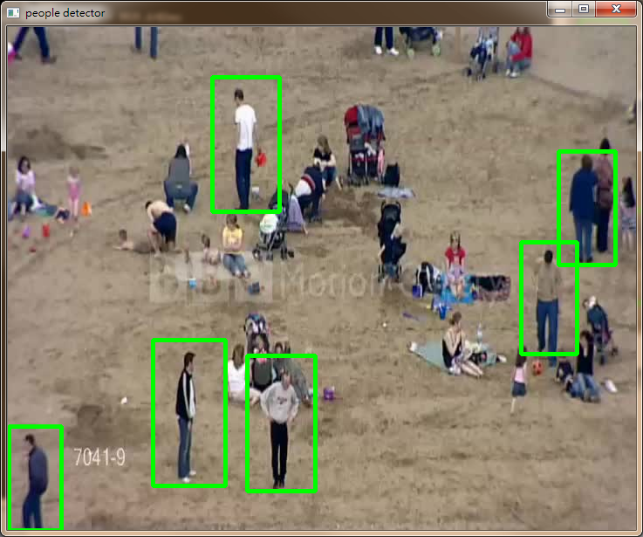
Challenge: variable appearance and the wide range of poses

Slide 4
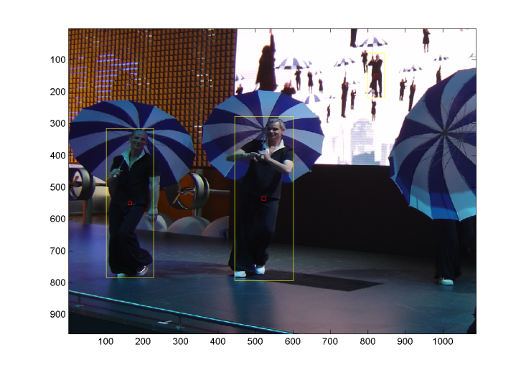
Challenges
Huge variation in different images
Scale
Pose / Clothing
Background variations
Color and Illuminations
Direct sunlight and shadows

Slide 5
Building blocks
Pixel
The smallest unit
Cell
Group of pixels (8 x 8)
Block
Group of cells (2 x 2)
Orientation bins
9 bins (0 – 180)

Slide 6
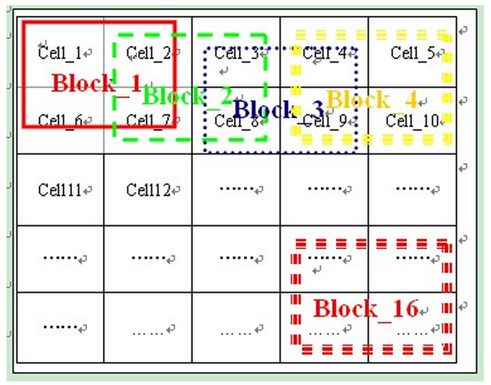
Spatial Division

Slide 7
HOG
Training
Positive and negative dataset
Normalization (block by block)
Spatial binning w.r.t orientation
Bin against each cell
Weighted voting (pixel by pixel), HOG (cell by cell)

Slide 8
HOG
Testing
Detection window (64 x 128)
Calculate HOG for the image segment on which detection window is placed
Classifier
Slide window
Sliding overlap
Scaling factors for pyramids
Pyramid height and depth

Slide 9
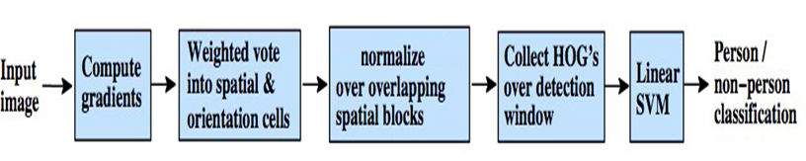
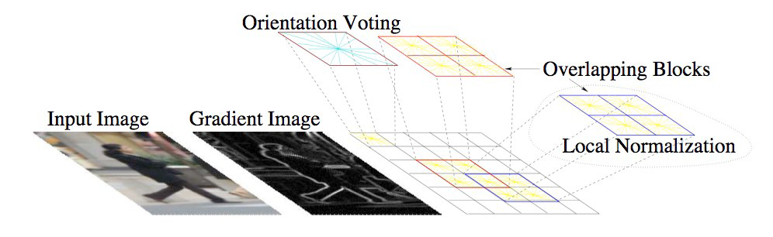
Summary

Slide 10
Why HOG?
Relatively invariant to local geometric and photometric transformations
Within cell rotations and translations do not affect the HOG values
Illumination invariance achieved through normalization

Slide 11
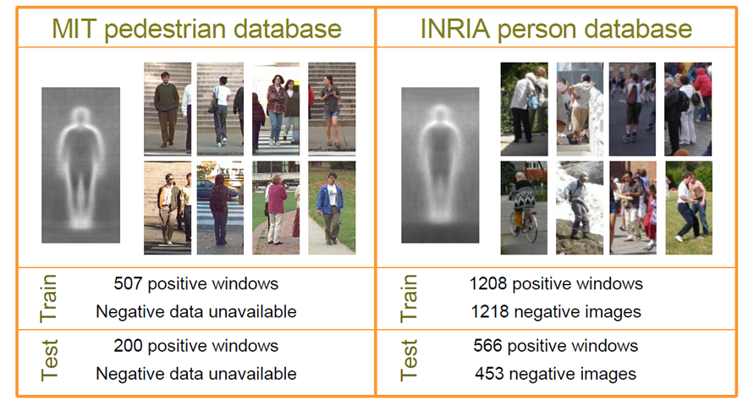
Data sets

Slide 12
Classifier
Test data
Belonging class

Slide 13
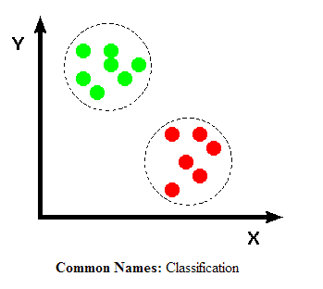
Binary Classifier
Classification between two classes
Person, not person (Our scenario)
Linear SVM classifier (in paper)

Slide 14
Classification
Two phases
Training
Data set
Learn features/parameters
Testing
Use features of training data set
Determine for the testing data to which class it belongs

Slide 15
Minimum to mean distance classifier
Uses mean vector of each data set
Take average of the HOGs of all the images (for both +ve and –ve training images)
Take distance of test image with both the average HOGs
Test image will belong to that class having minimum distance
There are many more classifiers

Slide 16
Parameters of HOG
Gray or color image
Gradients (Derivative techniques)
Spatial division (cell or block size)
Orientation binning
Cell or block overlapping size
Normalization method (cell, block normalization)
Classifier (linear kernal, guassian)
Accuracy method (FPPW, recall, precsion)

Slide 17
Implementation and Performance study with variation in parameters

Slide 18
1. Color
Gray scale
RGB
RGB give good results but restricting to gray scale
reduces performance by 1.5% at 10^-4 FPPW

Slide 19
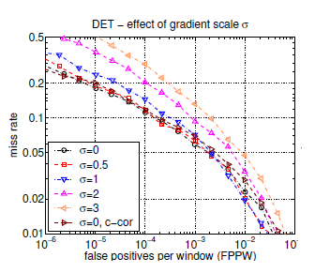
2. Gradient
Gaussians smoothing
with different derivative masks
1-D point derivatives [-1, 1], [-1, 0, 1]
Cubic masks [1, -8, 0, 8, -1]
Sobel masks, diagonal masks
With different smoothing scales (σ)
Best result: 1-D [-1, 0, 1] with σ = 0

Slide 20
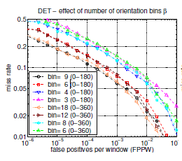
3. Spatial / Orientation binning

Slide 21
4. Normalization and descriptor block
Normalization takes the maximum range of a signal and stretches it to take up the maximum possible range
e.g. a simple normalization scheme: if the range of pixel values is 50-180 out of a total of 0-255 then min=50 and max =180,
normalization > (old_pix - min)*((max-min)/255)=new_pix
Other normalization schemes can be used
Group cells into larger blocks
Normalize within the blocks
Overlapping blocks

Slide 22
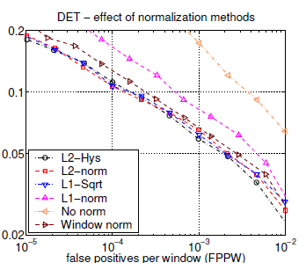
Effect of Normalization

Slide 23
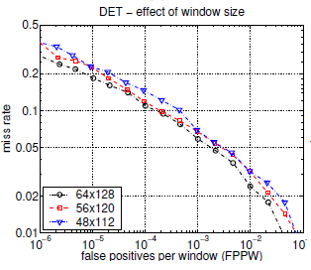
5. Detection Window
64 x 128 detection window
16 pixel margin on all four sides of the person
Decreasing 16-8 (48 x 112) decreases performance by 6%

Slide 24
Helping references:
http://en.wikipedia.org/wiki/Histogram_of_oriented_gradients
https://www.scss.tcd.ie/Gerard.Lacey/Gerard_Lacey_Homepage/CS4053_Course_files/Lecture%20009%20HOG-HOF.pdf

Slide 25


Slide 26
☺Thank you All☺

